Slide 1
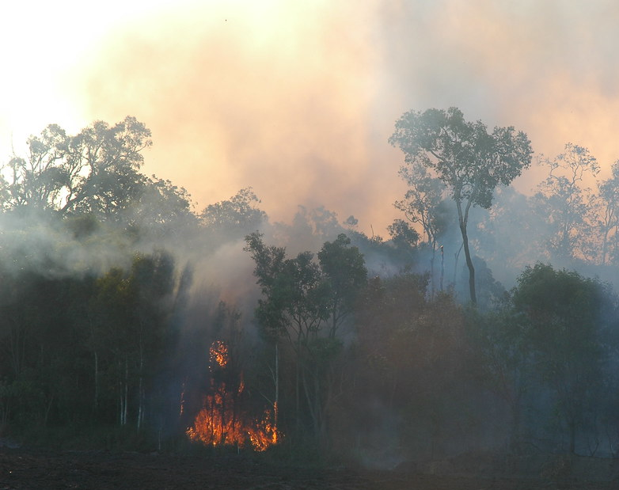
Flame Guard
Team: Blaze Battalion
This Photo by Unknown author is licensed under CC BY.

Slide 2
Team
CEO: Brent Duncan
CTO: Michael Le
CFO: Abhisek Kumar Shandilya
CMO: Sarita Aryal

Slide 3
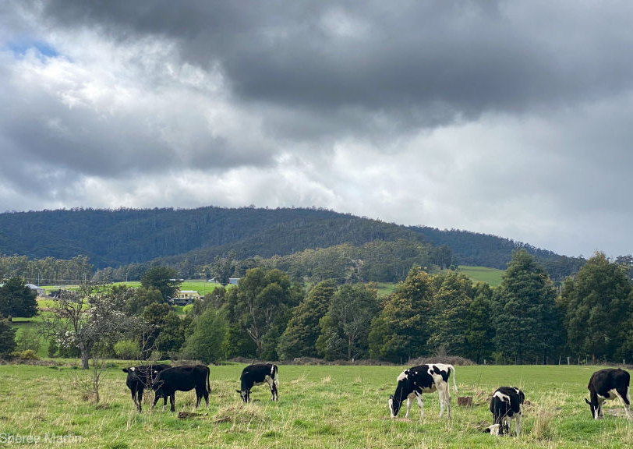
Scenario
Imagine yourself as a Farmer living out in the rural Australian countryside.

Slide 4
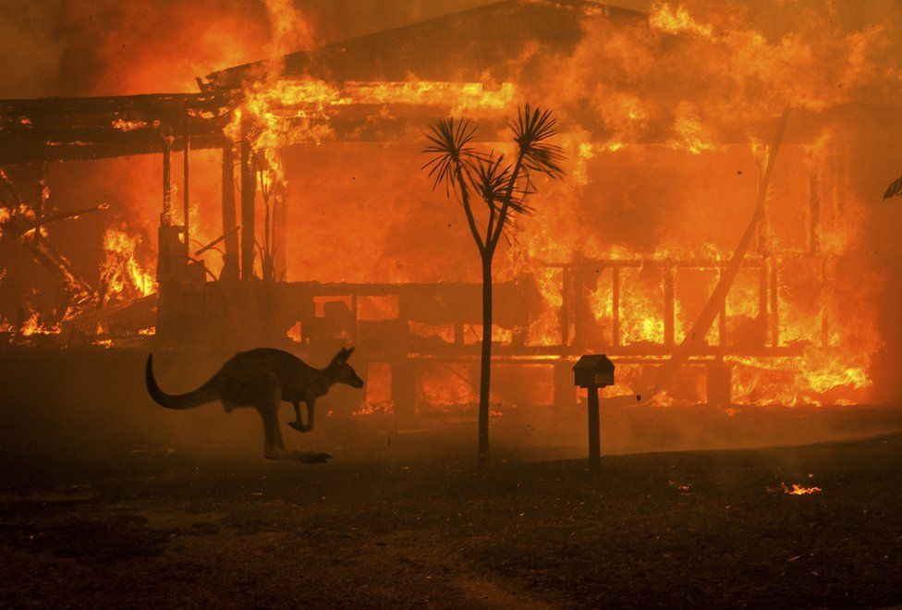
Issue and problem
Rural Australia towns and farms are frequently ravaged by bushfires.
An Estimated 3094 Homes were lost during the 2019-2020 bushfire alone.
These fires also cause damage to local wildlife and their habitats

Slide 5
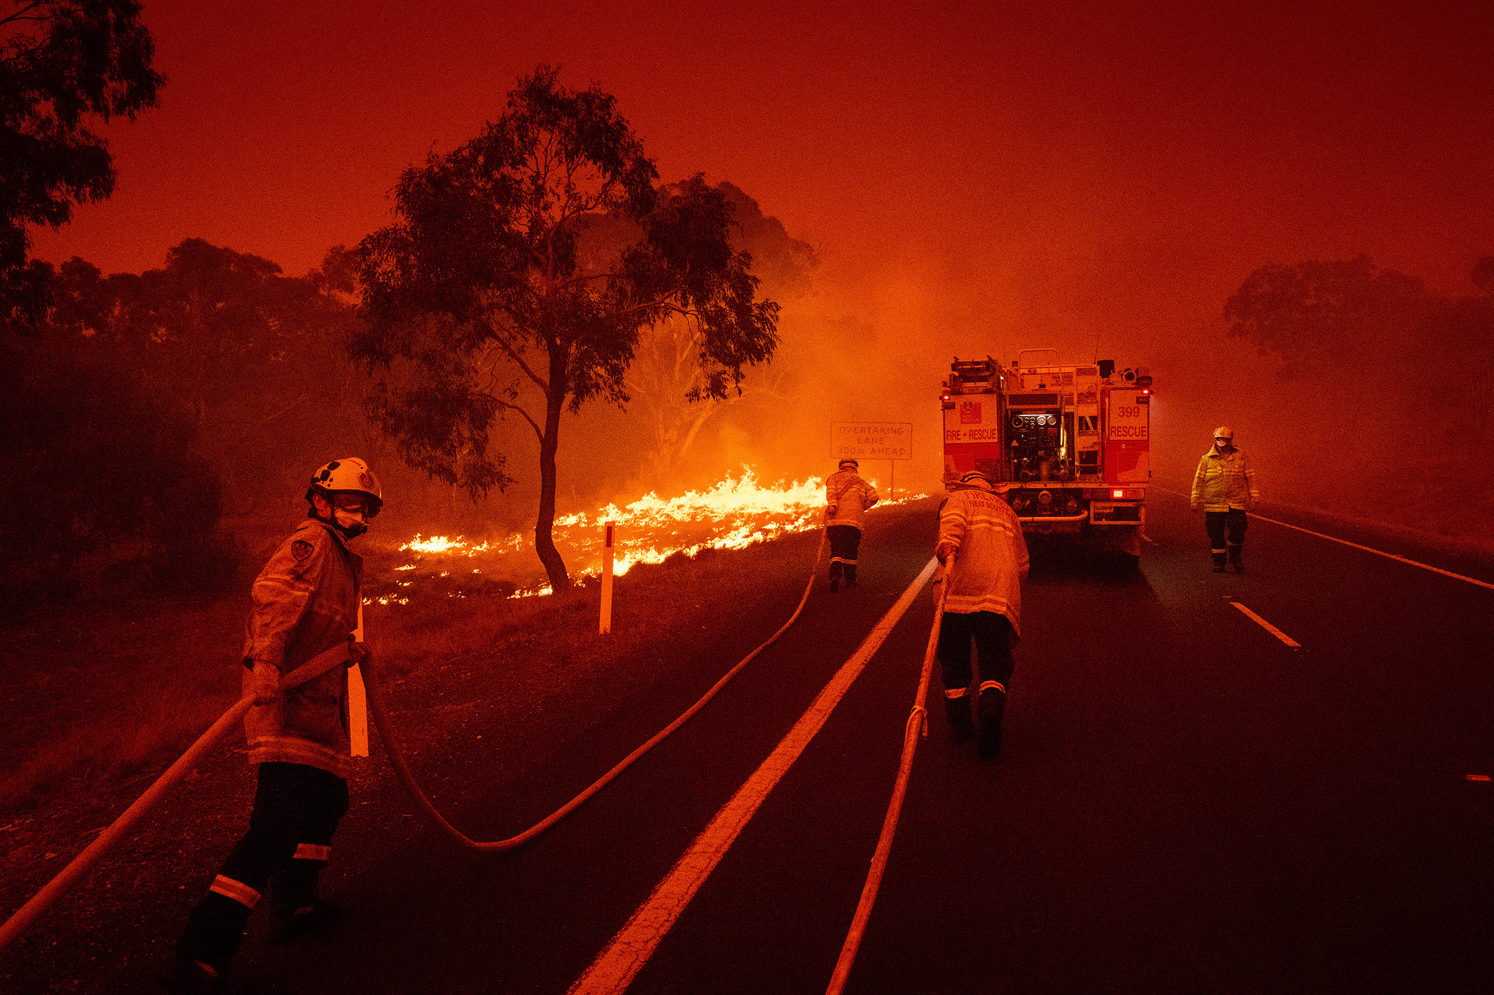
Issue and problem
There is a need for faster detection of bushfires
Enables fires to be caught early by firefighters
Gives people more time to evacuate

Slide 6
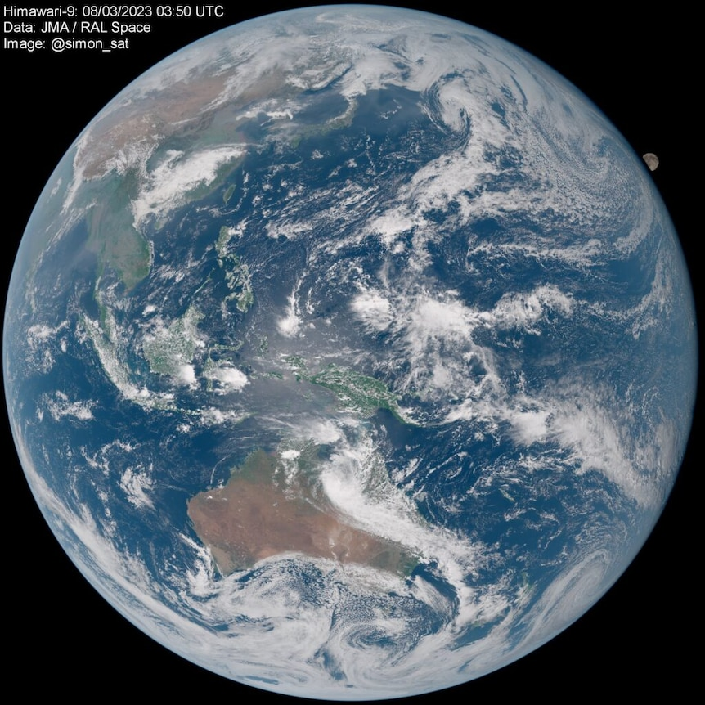
Attempted Solutions
The latest attempted solution was using satellites to detect bushfires
Geostationary satellites have reliable coverage but long delays between images
Lower satellites can provide clearer images but with inconsistent coverage

Slide 7

Market When conducting market research on fires situations, several essential factors must be considered in order to acquire an in-depth knowledge of the event and its consequences.

Slide 8
Impact on Industries
Geographical Scopes
Seasonality and Frequency
Government Policies and Regulations
Emergency response and Recovery Efforts
Technological solutions and Innovations
Long-term Environmental and Economic Implications

Slide 9
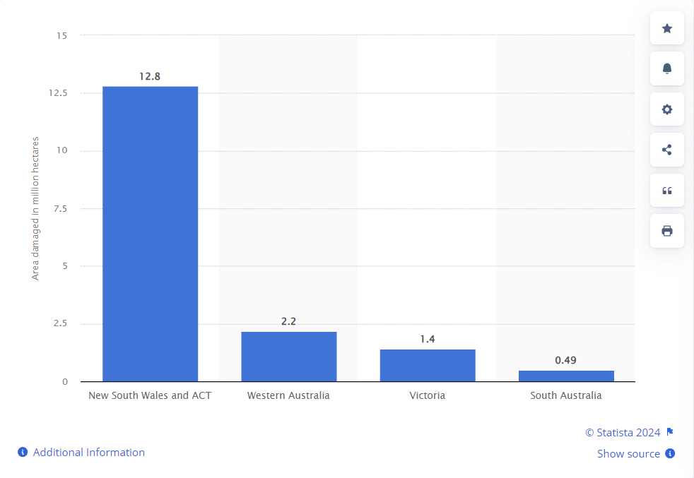
Figure 2: Total area burned by bushfires in Australia as of January 2020, by state (in million hectares)

Slide 10
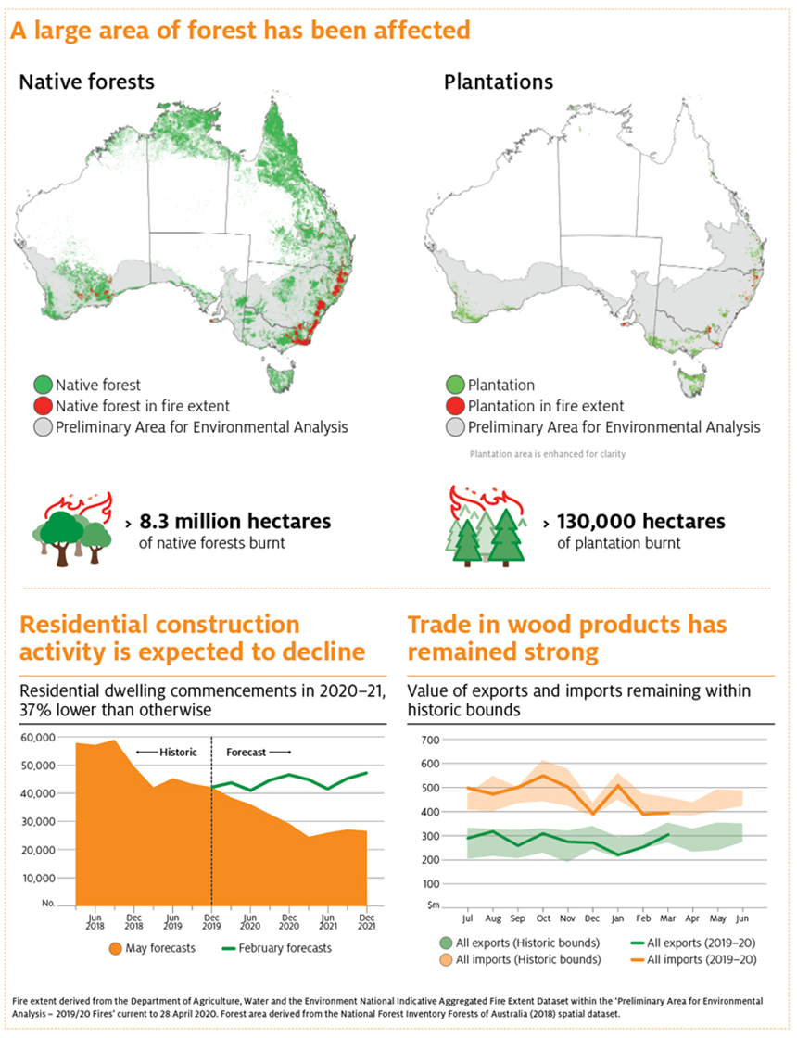
Figure 3: Data of bushfire affected area in Australia

Slide 11

"Australia to pay 'whatever it takes ' to fight wildfires."
Improved fire Management Project.
Increase Funding in firefighting resources.
Community Education and Awareness.
Climate change Mitigation and Adaption.
Post fire recovery and rehabilitation .
Collaboration with Indigenous Community.

Slide 12
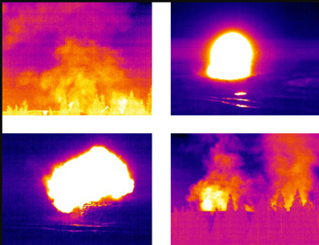
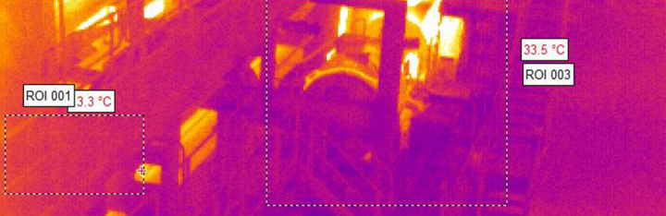
Tech/Product demo (prototype)
Solution: We made an environment for Amazon Cloud Web Services for cloud or local, applying infrared cameras in farms or other rural areas in Australia, enhancing early detection of potential fire outbreaks, reducing fire risks significantly. Localize places where, frequent bushfires occur, by integrating real-time data analysis and predictive algorithms, enhancing the accuracy of fire detection and response measures to saving millions of lives.
Issue: Flaws that occur with our product has a limited field of view and sensitivity to weather conditions, this leads to occasional false alarms. we measured up to 91% accuracy that our product-prototype is reliable.

Slide 13
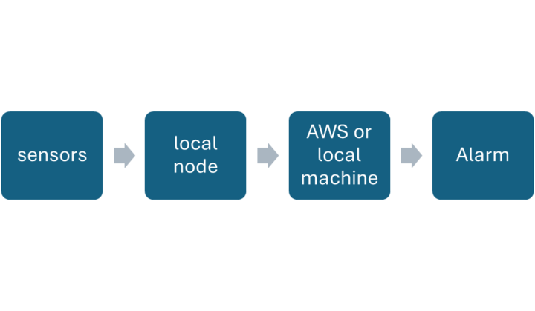
An overview of the solution to build an Infrared camera detection system to alert bushfires.

Slide 14
Cost
Subscription
One time hardware purchase

Slide 15
Customer Experience
Early Detection
Precision and Accuracy
Challenges
Overall Satisfaction

Slide 16
References
https://forms.gle/C4CkYpWzjW3sAb3AA
World Leading Bushfire Safety Tech Installation Complete | Premier of Victoria
Fire Drill! Thermal Cameras and Smoke | Ivy Tools Blog
Amazon Rekognition – Pricing - AWS
https://www.dtf.vic.gov.au/victorias-economic-bulletin-volume-5/economic-impacts-2019-20-bushfires-victoria
https://www.sydney.edu.au/news-opinion/news/2021/12/13/black-summer-2019-20-bushfires-cost-farmers-5-billion-australia.html
https://www.abc.net.au/news/science/2023-08-30/bushfires-can-be-detected-from-space-within-minutes-of-ignition/102765624
https://www.ffm.vic.gov.au/__data/assets/pdf_file/0024/19743/Great-Divide-fire-recovery-plan.pdf
https://www.aph.gov.au/About_Parliament/Parliamentary_departments/Parliamentary_Library/pubs/rp/rp1920/Quick_Guides/AustralianBushfires
Refer to Business Report for more information.

